Slide 1

British Airways
Data-Driven Insights, Review Analysis
Hriday Shah

Slide 2
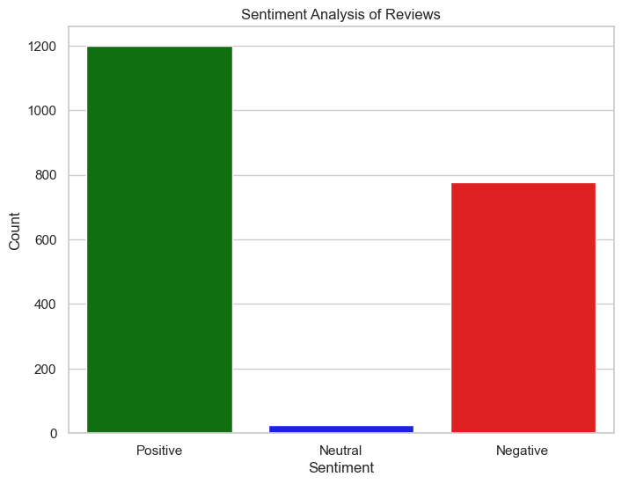
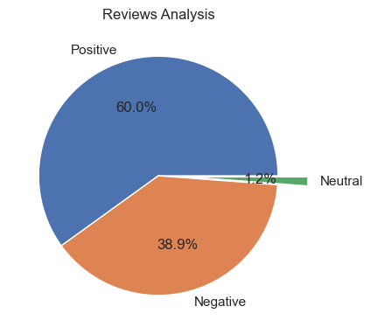
Insights form Company (Textual Review) Data
Data Web scraped
Positive 1199
Negative 777
Neutral 24
Reviewa

Slide 3
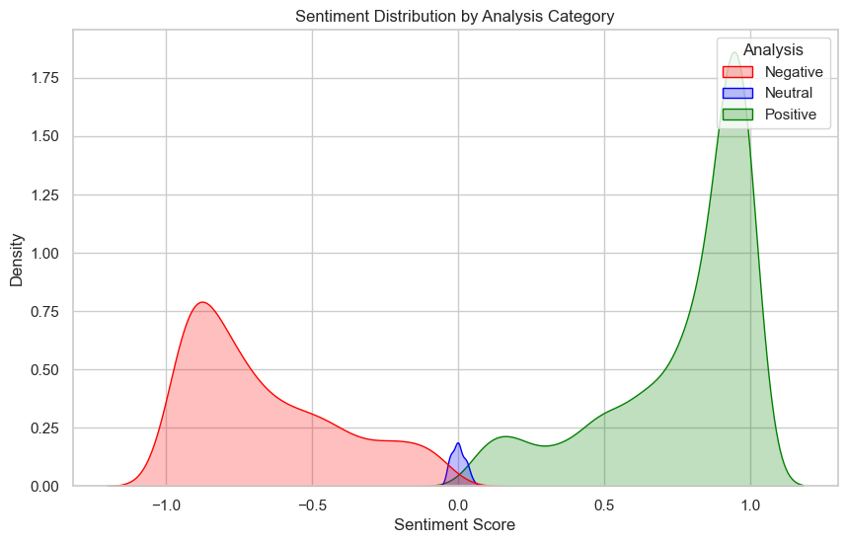

Slide 4

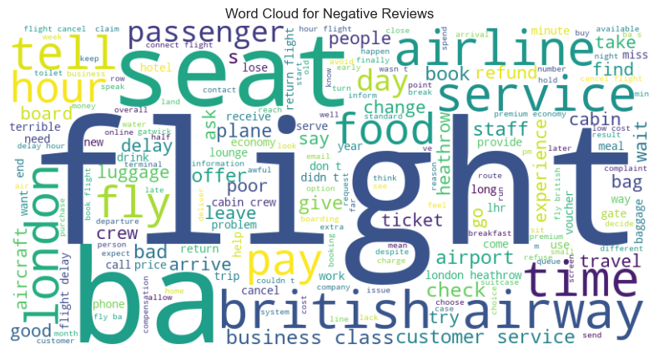


Slide 5
Comparing the Ratings

Slide 6
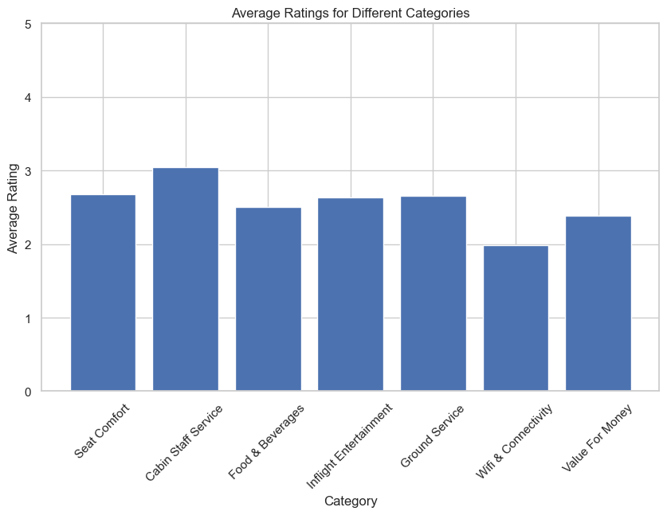
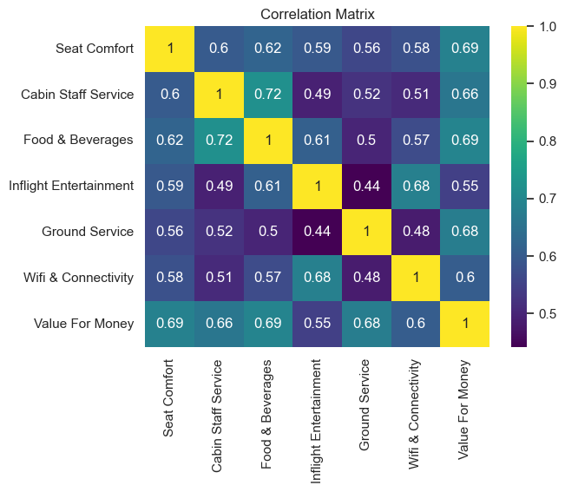

Slide 7
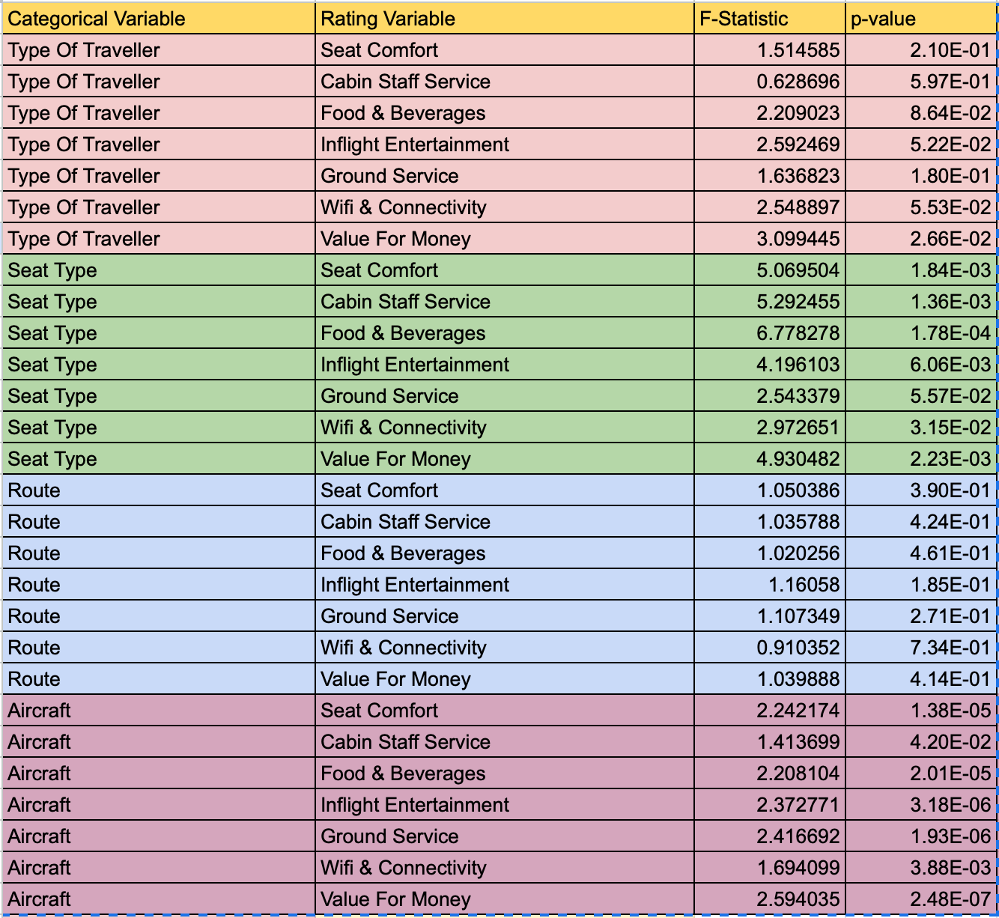

Slide 8
